Slide 1

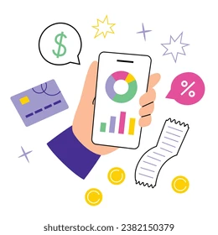
PERSONAL FINANCE TRACKER

Slide 2

WHY DO WE NEED A FINANCE TRACKING APP?

Slide 3

MODERN PROBLEMS WITH MONEY MANAGEMENT
Overspending & Impulse Buying
Subscription Overload
Lack of Emergency Funds
Financial Illiteracy
Inflation and Cost of living Crisis
Notes:
INTRO TO PROBLEM

Slide 4

MANAGING INCOME/EXPENSES
Lack of budgeting awareness
No saving discipline
No real time financial insights
Notes:
PROBLEM

Slide 5

PEOPLE AFFECTED THE MOST
Young Adults and students
Low - income households
Middle Class Families
Small Business owners
Notes:
WHO IS FACING IT THE MOST

Slide 6
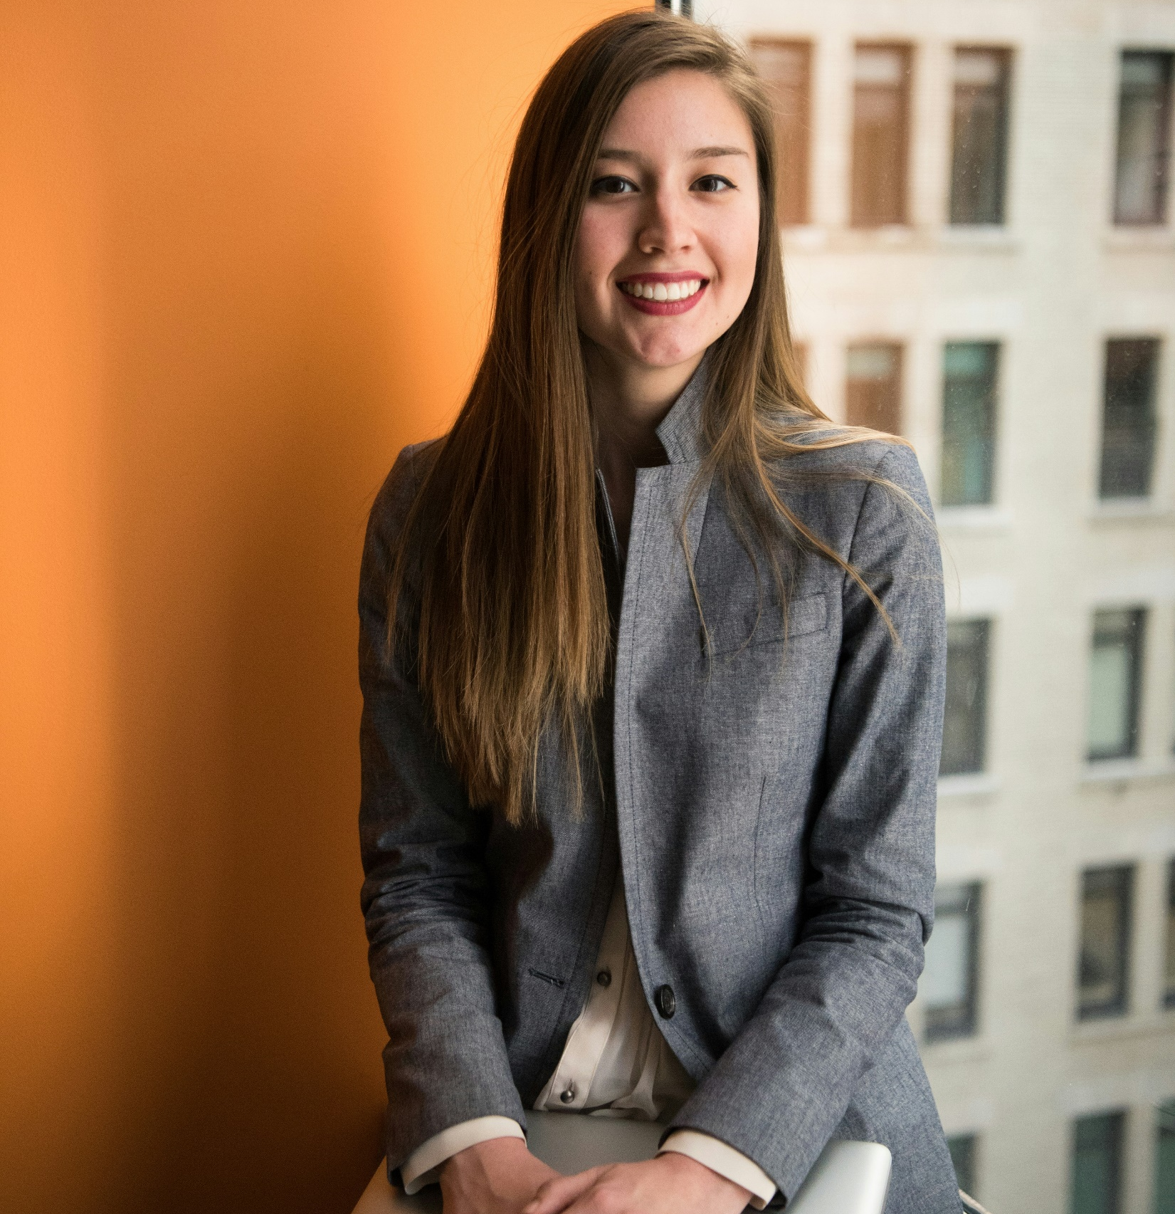
Name: Stephanie Adams
Age: 28yrs
Occupation: Marketing Manager @ corporate firm
Location: Adelaide, AUS
FINANCIAL CHALLENGES:
Struggling with tracking Expenses & overspending
Forgets to make timely payments of bills
Don’t have better insights about her financial situation.
GOALS and NEEDS:
Saving goals
Smart Notifications for timely payment
Easy to use budgeting tools.

Slide 7


SOLUTION AVAILABLE IN THE MARKET
MONEYFY
Strengths: - Extremely user-friendly UI - Quick expense tracking - Great for visual spending analysis.
Weakness:
- Lacks budgeting features - No shared budgeting - No bill reminders or savings goals
BUDDY
Strengths:
- Strong budgeting features - Shared budgeting for families/friends - User-friendly interface Weakness:
- Lacks bill reminders - Less focus on expense tracking - Limited savings goal features
Notes:
USER PERSONA

Slide 8
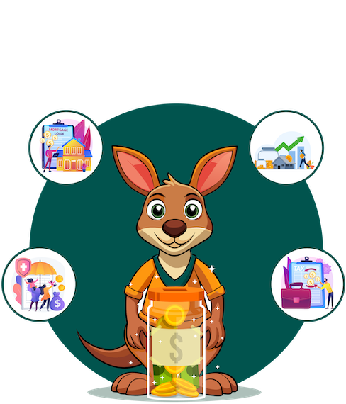
WE PROPOSE A NEW SOLUTION!
SAVEMATE

Slide 9
COMPARISON WITH OUR APP
FEATURES | MONEYFY | BUDDY | SAVEMATE
EXPENSE TRACKING | Simple UI | Shared tracking | Advance reports and tracking
BUDGETING | NO Budgeting | Group & Personal | Custom Budgeting
BANK AND CASH TRACKING | No Tracking | No Tracking | Provided tracking with user permission
REPORTS AND ANALYSIS | Basic Charts | Basic trends | Graphs and AI insights on spending
BILL REMINDERS | No reminders | Limited support | Custom bill reminders
SAVING GOALS | None | Limited | Custom
Notes:
APPS ALREADY IN THE MARKET

Slide 10
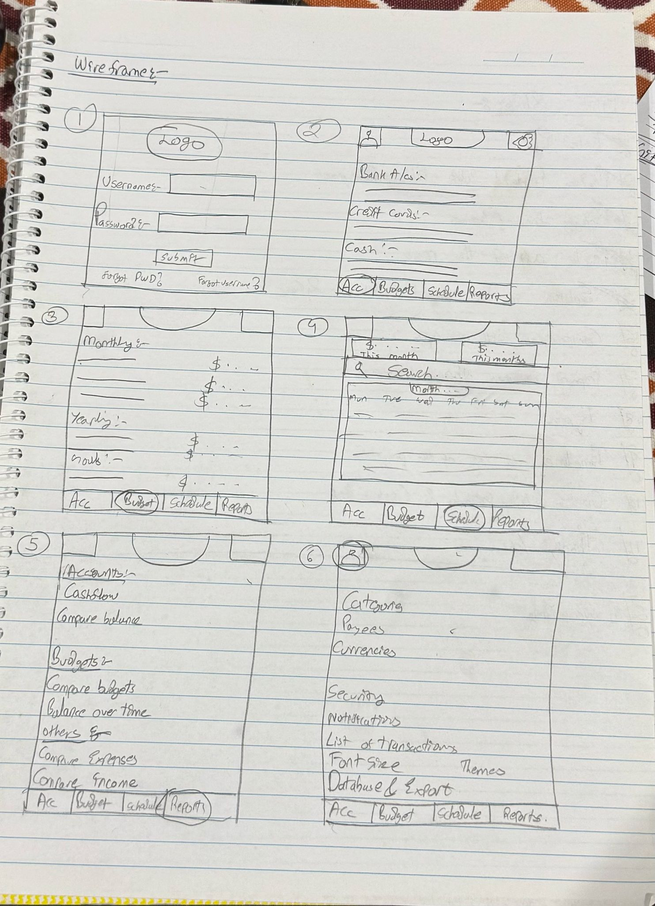
PROPOSED FEATURES VIA WIREFRAME
Notes:
WHAT THEY HAVE TO OFFER

Slide 11
LINK TO FIGMA PROTOTYPE
https://www.figma.com/design/RPtluib9fA09i6xoZ3qmXR/SaveMate?node-id=0-1&t=MEcVx6HtM2R2QYF3-1
Notes:
WHY IS MINE DIFF

Slide 12
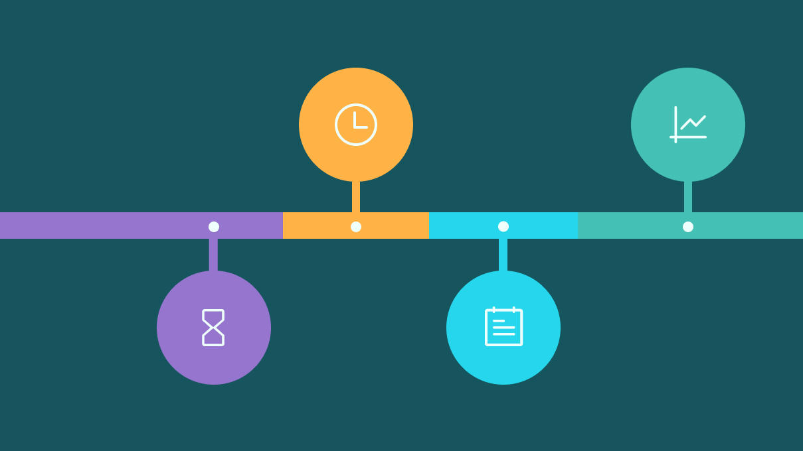
TIMELINE OF THE PROJECT
WEEK 1: Planning and research on the topic.
WEEK 2 & 3: UI design and prototyping
WEEK 4&5: Backend development of the proposed app
WEEK 6: Going through the features available in the app
WEEK 7&8: Testing and addressing problems
WEEK 9: Documentation and going through everythin
WEEK 10: Preparing Cover Video and Submission
Notes:
WIREFRAME OF MINE

Slide 13

GIT-HUB
ROLE OF GIT IN THE PROJECT:
Version Control: Helps tracking changes and making changes
Collaboration: Helps other people to collab on the project
Project Organisation: Keeps the Project properly structured and neat for other people to see
LINK TO GIT: https://github.com/Ghosttt99/MobileComputingAssessment01.git
Notes:
FIGMA OF MINE

Slide 14

Notes:
GITHUB

